Slide 2
Опции развертывания ASP.NET Core локально, в облаке, контейнерах
Сычев Игорь
Dev/Azure PFE, Microsoft

Slide 3
Kestrel
Containers
Linux

Slide 4



Hosting OS
ASP.NET Core
Universal Windows Apps
.NET Core
Common
Runtime Components
Compilers
NuGet packages
Next gen JIT (RyuJIT)
SIMD
Languages innovation
.NET Compiler Platform
.NET Core Libraries
.NET Framework 4.6 Libraries

Slide 5
Где мы можем хостить Asp.Net Core apps?
IIS on Windows
Windows Server (Nano/Core/Full)
Docker container
Hyper-V container
Azure
Service Fabric
Web/Mobile Apps
VMs
Linux
MacOSX
Linux Containers
Apache/Nginx on Linux/Windows
Windows 10 IOT on Raspberry PI

Slide 6
Requests forwarding
IIS
Kestrel
Apache
Nginx

Slide 7
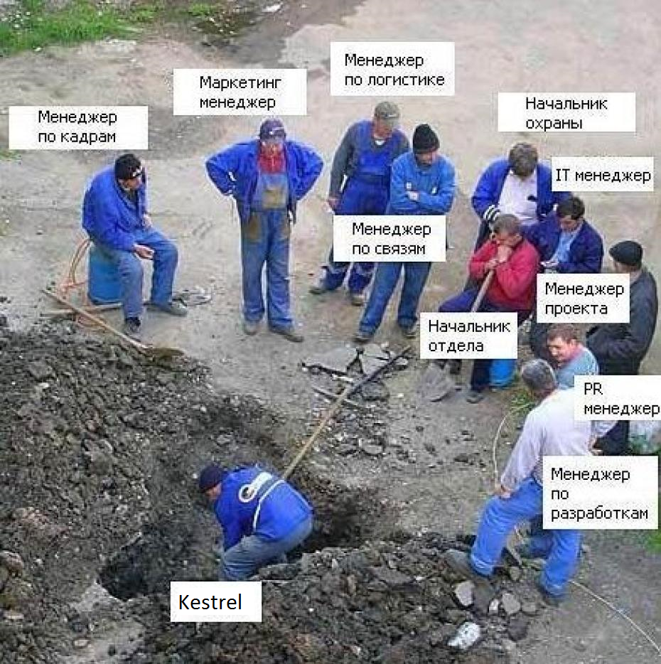
Что такое Kestrel?
Старое определение
- “Development Ready Web Server”
Правильное определение:
Веб сервер, который на самом деле хостит веб приложение на asp.net core, используя в качестве front end серверов- всех остальных.
Notes:
https://docs.asp.net/en/latest/fundamentals/servers.html
https://docs.asp.net/en/latest/fundamentals/request-features.html
https://docs.asp.net/projects/api/en/latest/autoapi/Microsoft/AspNet/Http/Features/index.html

Slide 8
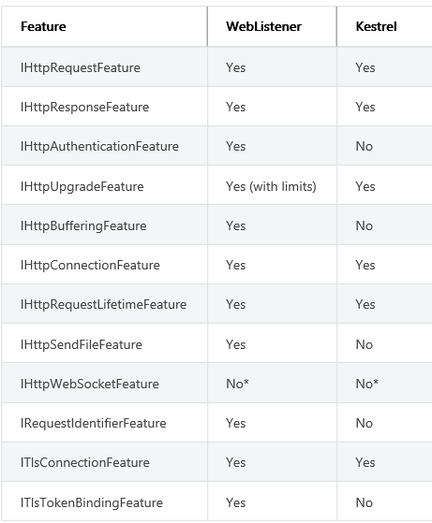
HTTP Features сравнение
Notes:
https://docs.asp.net/en/latest/fundamentals/servers.html
https://docs.asp.net/en/latest/fundamentals/request-features.html
https://docs.asp.net/projects/api/en/latest/autoapi/Microsoft/AspNet/Http/Features/index.html

Slide 9
Что там с Web listener?
RC1 age version 1.0.0-rc1
RC2 age version 0.1.0-rc2
Notes:
https://github.com/aspnet/Announcements/issues/182
https://github.com/aspnet/Announcements/issues/181

Slide 10
HTTP Platform Handler
Native IIS module необходимый для хостинга ASP.NET Core на IIS
HTTPPlatformHandler нужен для
Process Management of HTTP listeners
Proxy requests to the processes, it manages
Advantages:
IIS App Pool does not run any managed code (CLR loading is not required)
Existing ASP.NET windows components are not required to be installed
Separate process for ASP.NET Core 1; existing ASP.NET modules can run alongside

Slide 11
Windows Kestrel/IIS

Slide 12
Linux
Notes:
https://www.microsoft.com/net/core#Ubuntu
sudo sh -c 'echo "deb [arch=amd64] https://apt-mo.trafficmanager.net/repos/dotnet/ trusty main" > /etc/apt/sources.list.d/dotnetdev.list'
sudo apt-key adv --keyserver apt-mo.trafficmanager.net --recv-keys 417A0893
sudo apt-get update
sudo apt-get install dotnet-dev-1.0.0-preview1-002702
test .net core machine is working fine using this commands
git clone https://github.com/aspnet/Home
cd Home/samples/1.0.0-rc1-update1/HelloMvc
open web site using http:{vm public ip}:5004

Slide 13
Контейнеры

Slide 14
Зачем нам контейнеры, если и так уже есть виртуализация?
Containers это следующая стадия virtualization.
Notes:
https://msdn.microsoft.com/en-us/virtualization/windowscontainers/about/about_overview
https://azure.microsoft.com/en-us/blog/containers-docker-windows-and-trends/ from mark Russinovich

Slide 15
Зачем контейнеры разработчику?
Приложение работает на моей машине…
Я не хочу тратить время на развертывание приложения на других машинах
и тем более не хочу разбираться почему оно не работает.
Notes:
From a developer’s desktop to a testing machine to a set of production machines, a Docker image can be created that will deploy identically across any environment in seconds. This story has created a massive and growing ecosystem of applications packaged in Docker containers, with DockerHub, the public containerized-application registry that Docker maintains, currently publishing more than 180,000 applications in the public community repository.
When you containerize an app, only the app and the components needed to run the app are combined into an "image". Containers are then created from this image as you need them. You can also use an image as a baseline to create another image, making image creation even faster. Multiple containers can share the same image, which means containers start very quickly and use fewer resources. For example, you can use containers to spin up light-weight and portable app components – or ‘micro-services’ – for distributed apps and quickly scale each service separately.
Because the container has everything it needs to run your application, they are very portable and can run on any machine that is running Windows Server 2016. You can create and test containers locally, then deploy that same container image to your company's private cloud, public cloud or service provider. The natural agility of Containers supports modern app development patterns in large scale, virtualized and cloud environments.
With containers, developers can build an app in any language. These apps are completely portable and can run anywhere - laptop, desktop, server, private cloud, public cloud or service provider - without any code changes.
Containers helps developers build and ship higher-quality applications, faster.

Slide 16
Я админ- зачем мне эти ваши контейнеры!?
У меня уже есть Chef/Puppet/DSC/DevOps/ALM, мегабайты powershell scripts, Gold Images.
А давайте все это упростим и запакуем приложение в такой контейнер, разворачивание которого- это копирования его на целевой сервер?!
Notes:
IT Professionals can use containers to provide standardized environments for their development, QA, and production teams. They no longer have to worry about complex installation and configuration steps. By using containers, systems administrators abstract away differences in OS installations and underlying infrastructure.
Containers help admins create an infrastructure that is simpler to update and maintain.

Slide 17
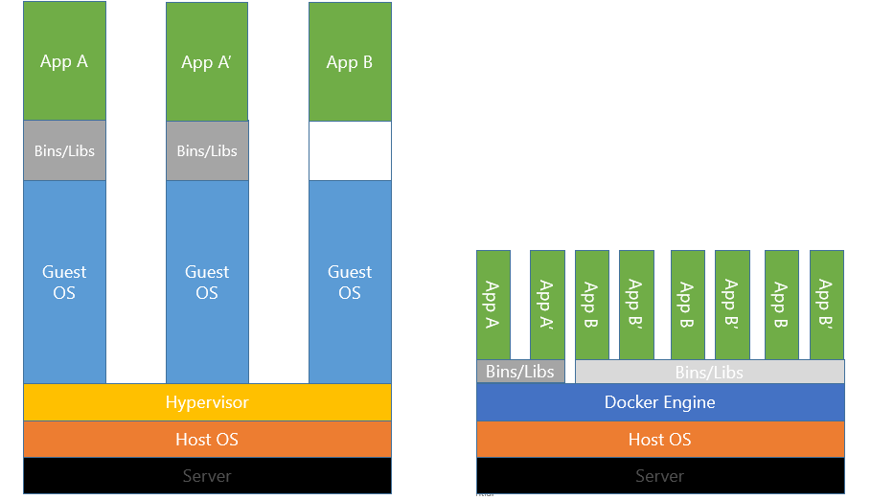
Контейнеры VS виртуализация

Slide 18
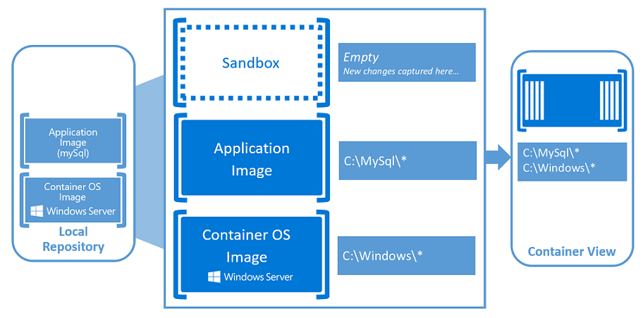
Containers idea
Notes:
Container Host: Physical or Virtual computer system configured with the Windows Container feature. The container host will run one or more Windows Containers.
Container Image: As modifications are made to a containers file system or registry, such as with software installation they are captured in a sandbox. In many cases you may want to capture this state such that new containers can be created that inherit these changes. That’s what an image is – once the container has stopped you can either discard that sandbox or you can convert it into a new container image. For example, let’s imagine that you have deployed a container from the Windows Server Core OS image. You then install MySQL into this container. Creating a new image from this container would act as a deployable version of the container. This image would only contain the changes made (MySQL), however would work as a layer on top of the Container OS Image.
Sandbox: Once a container has been started, all write actions such as file system modifications, registry modifications or software installations are captured in this ‘sandbox’ layer.
Container OS Image: Containers are deployed from images. The container OS image is the first layer in potentially many image layers that make up a container. This image provides the operating system environment. A Container OS Image is Immutable, it cannot be modified.
Container Repository: Each time a container image is created the container image and its dependencies are stored in a local repository. These images can be reused many times on the container host. The container images can also be stored in a public or private registry such as DockerHub so that they can be used across many different container host.
Container Management Technology: Windows Containers can be managed using both PowerShell and Docker. With either one of these tools you can create new containers, container images as well as manage the container lifecycle.

Slide 19
Linux Container

Slide 20
Linux Containers
Notes:
https://docs.asp.net/en/latest/getting-started/installing-on-linux.html#using-docker

Slide 21
Windows Server 2016

Slide 22
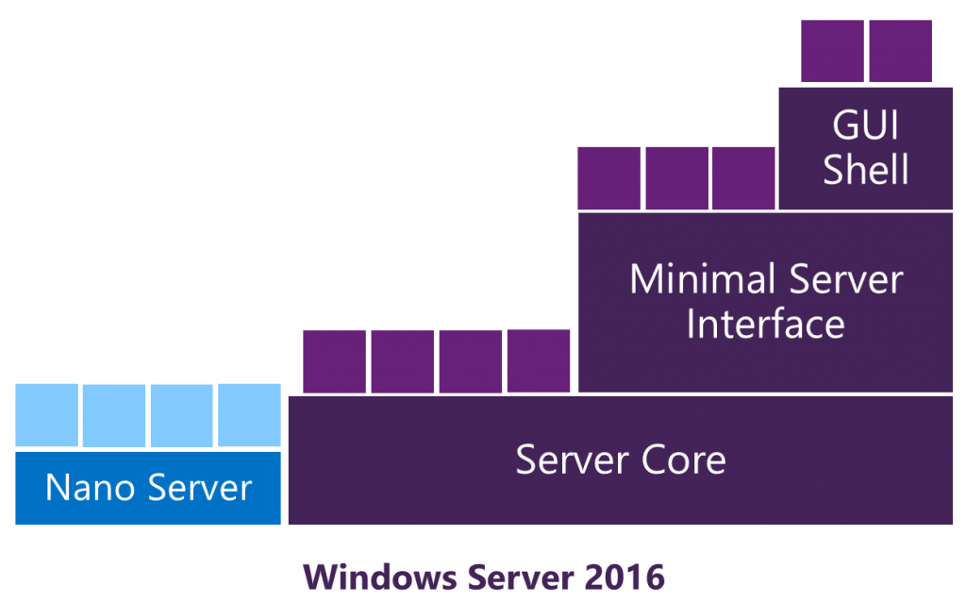
Windows Server 2016 versions
Notes:
https://channel9.msdn.com/Series/Nano-Server-Team
https://channel9.msdn.com/Series/Nano-Server-Team/Demo-Nano-Server-in-a-Container-running-IIS-ASPNET5

Slide 23
Windows Container

Slide 24
Типы Containers для Windows
Docker Containers- docker совместимые контейнеры
Windows Server Containers – provide application isolation through process and namespace isolation technology. A Windows Server container shares a kernel with the container host and all containers running on the host.
Hyper-V Containers – expand on the isolation provided by Windows Server Containers by running each container in a highly optimized virtual machine. In this configuration the kernel of the container host is not shared with the Hyper-V Containers.
Notes:
https://blogs.technet.microsoft.com/server-cloud/2015/11/19/announcing-the-release-of-hyper-v-containers-in-windows-server-2016-technical-preview-4/

Slide 25
Windows Containers
Notes:
OPTIONAL
https://msdn.microsoft.com/en-us/virtualization/windowscontainers/quick_start/manage_docker
You may demonstrate it in Azure, since it’s not hyper-v based, it’s feature of Windows server 2016. All- Core,Full,Nano version supporting containers

Slide 26
Azure Service Fabric

Slide 27
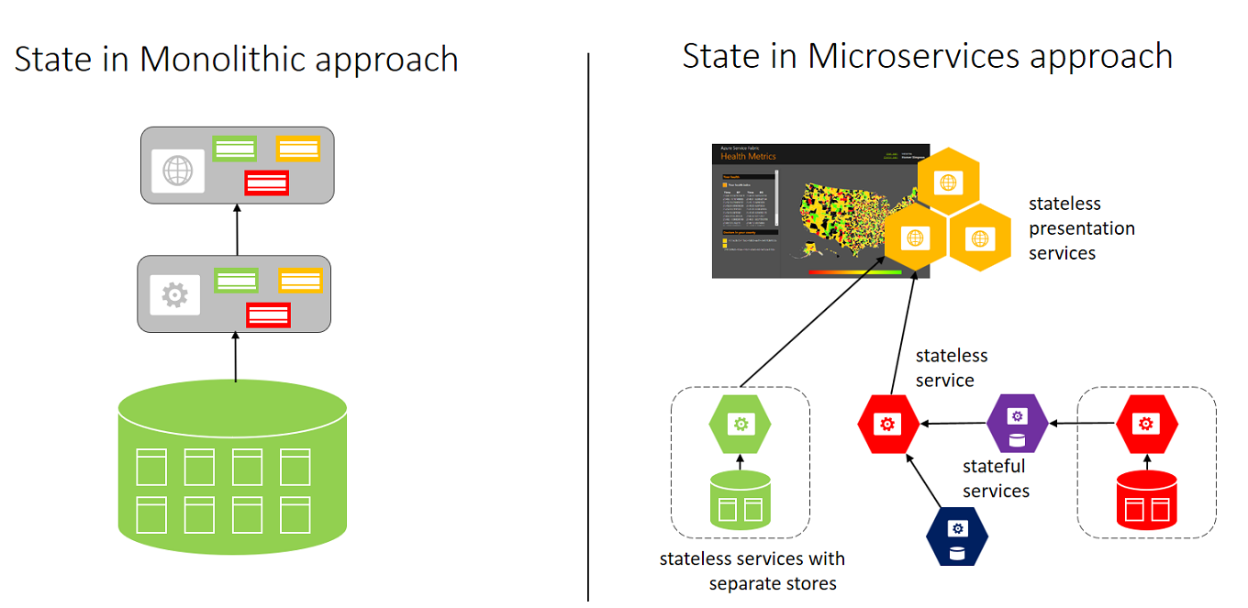
Service Fabric и Microservices

Slide 28
Зачем нам Asp.Net Core в Service Fabric
By default, Azure Service Fabric services do not provide a public interface to the web. To expose your application's functionality to HTTP clients, you will need to create a web project to act as an entry point and then communicate from there to your individual services.
Notes:
Useful links https://azure.microsoft.com/en-us/documentation/articles/service-fabric-application-scenarios/
https://azure.microsoft.com/en-us/documentation/articles/service-fabric-reliable-services-communication-webapi/

Slide 29
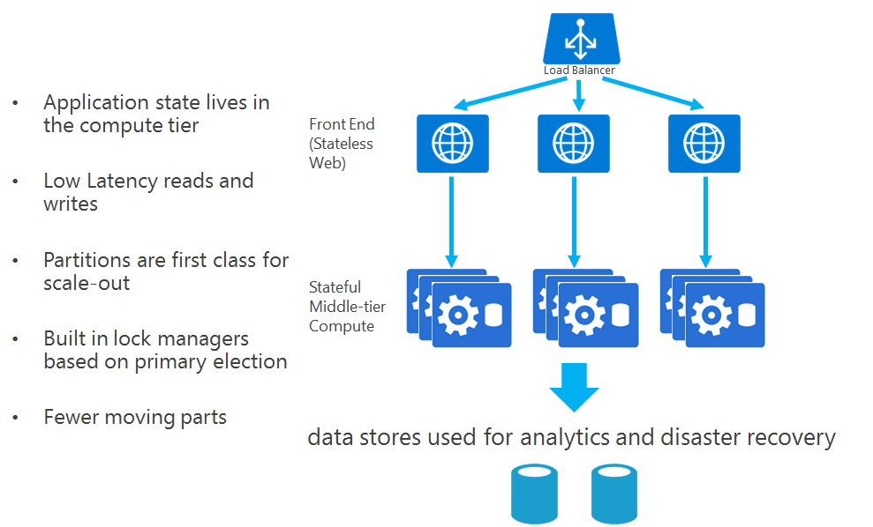
StateFul Services

Slide 30
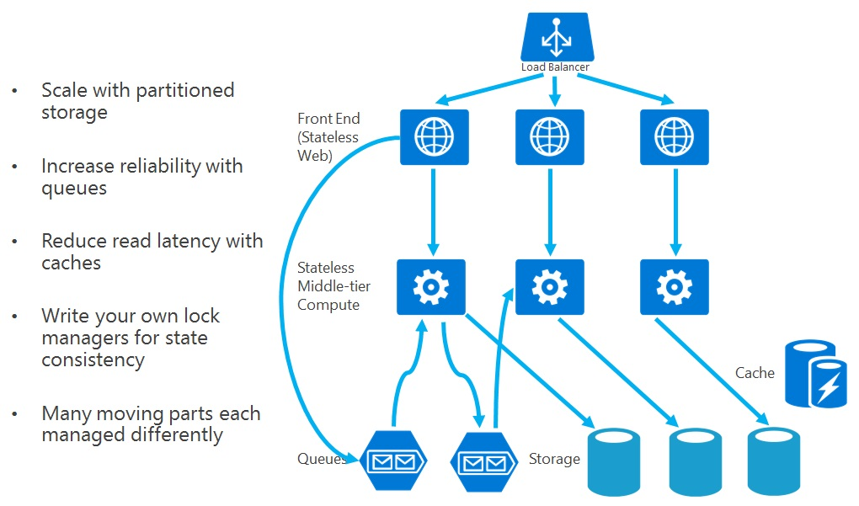
Stateless Services

Slide 31
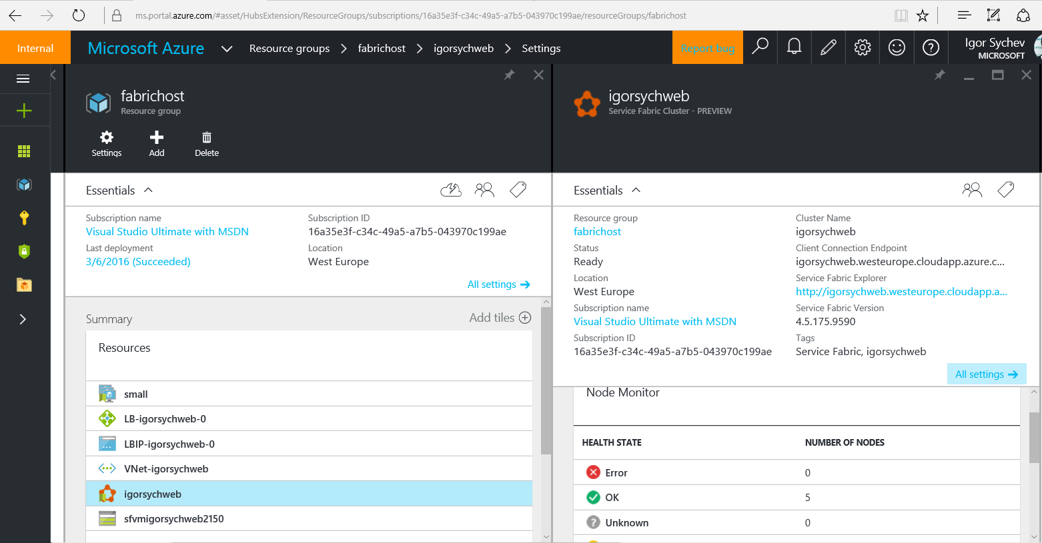
Notes:
Cluster in Azure. March 2016

Slide 32
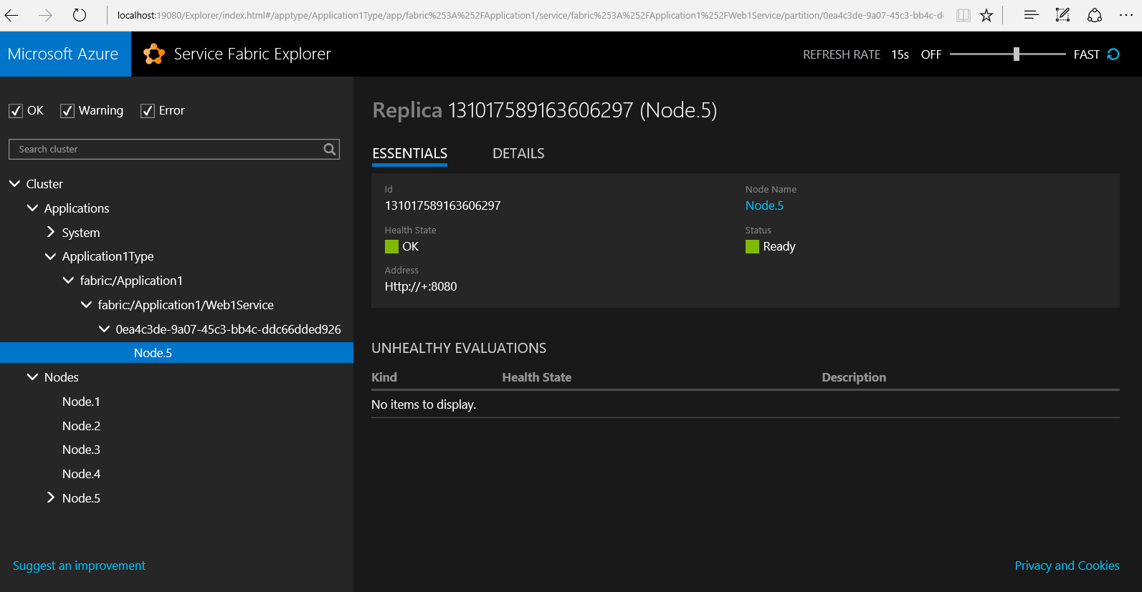
Notes:
Cluster Explorer view

Slide 33
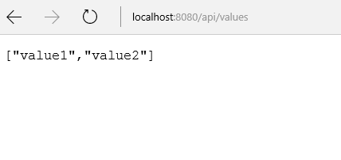
Notes:
Web api call

Slide 34
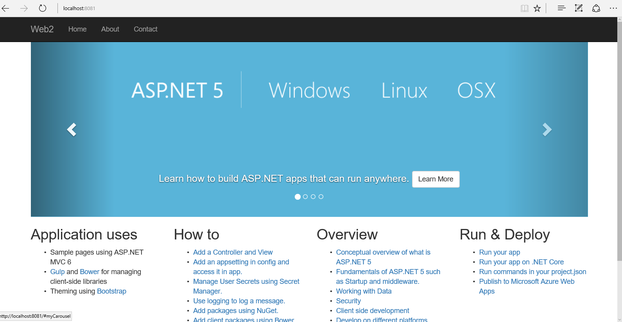
Notes:
Web Site Call

Slide 35
Кратко
Вы узнали, что такое Kestrel
Вы можете хостить ваши Asp.Net Core приложения почти где угодно
Linux для Asp.Net Core- родная операционная система
Asp.Net Core работает внутри контейнеров

Slide 36
Практика
Выберите себе упражнение на ваш вкус

Slide 37
Опции развертывания ASP.NET Core локально, в облаке, контейнерах
Игорь Сычев

